Slide 1
MC3_2018
By: Akshat Baranwal

Slide 2
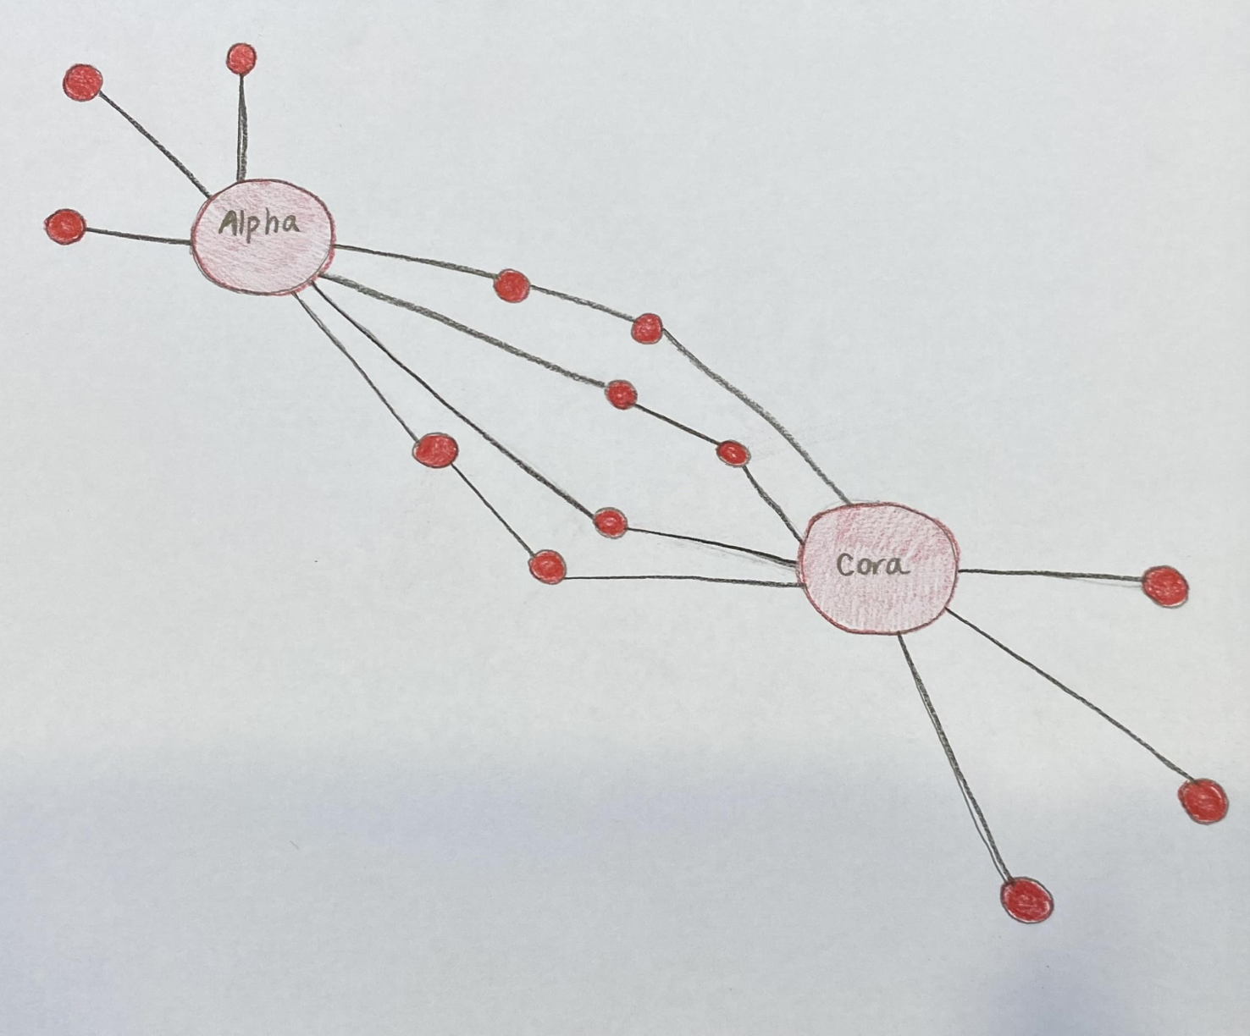
Final Sketch Design

Slide 3
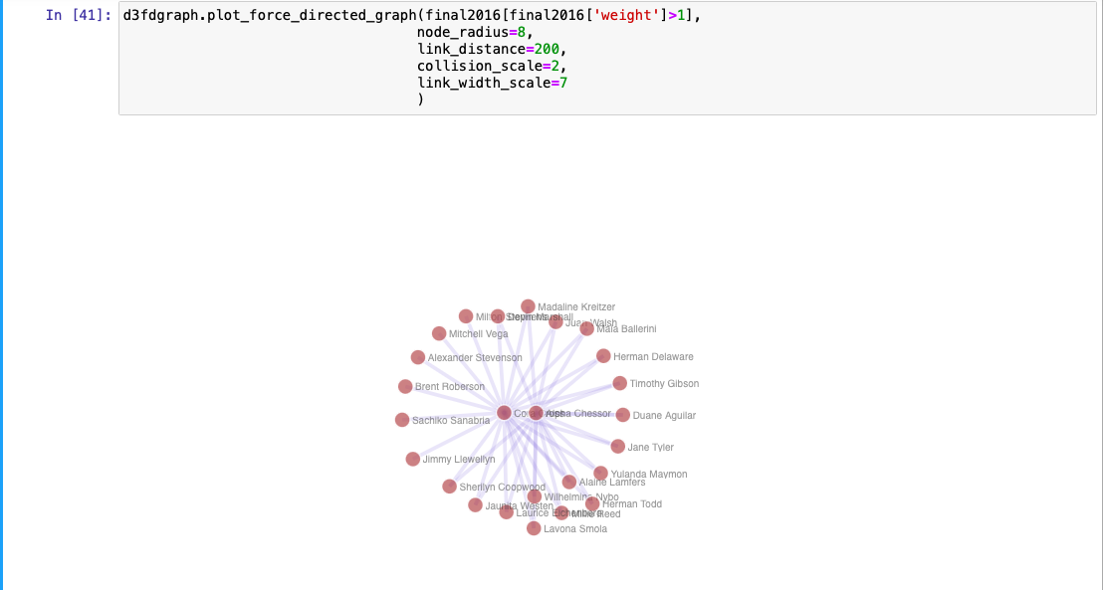
Visualization of Suspicious communication as of June 13, 2016

Slide 4
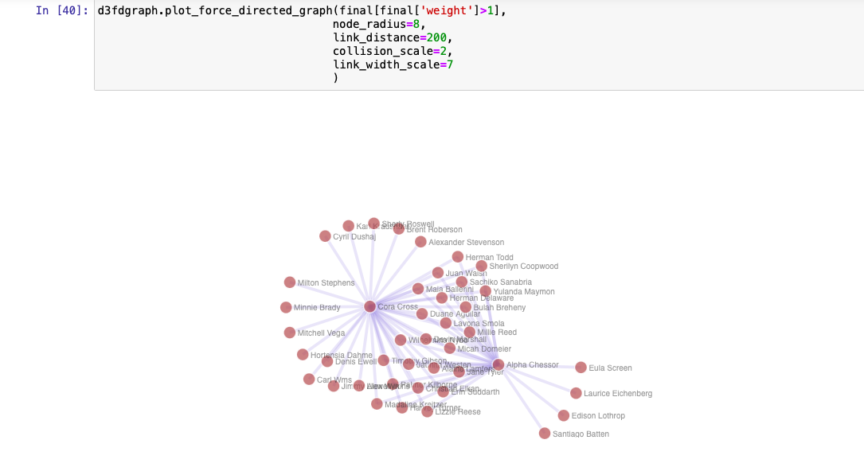
Visualization of Suspicious communication as of December 30, 2017

Slide 5
D3 Summary
The amount of communication has grown significantly in this group and more people were added to their suspicious communication. Our D3 Visualization shows that this is the case. Each node represents a person and by comparing the June 2016 time to the December 2017 time, it is clear there are more people and the suspicious group has grown.

